Slide 1
BOLO Version 3.0 Team Member(s): Ryan del Rosario, Rodney Sanchez Product Owner(s): Chief Samuel Ceballos, Major Jason Cohen Instructor:Masoud Sadjadi School of Computing and Information Sciences Florida International University
Senior Project Final Presentation Fall 2015

Slide 2
Problem definition
The BOLO Flier Creator is an application that seeks to simplify the process of creating and distributing Be On the Look Out information
My Part
Port current implementation out of WordPress/PHP environment to a NodeJS environment on IBM Bluemix Platform (PaaS)
Design and Implement features with scalability and security in mind
Using OWASP (Open Web Application Security Project) Recommendations
Design the application to be run as multiple instances

Slide 3
System Design: Architecture
Notes:
The project is using a hexagonal architecture (sometimes called ports and adapters or onion architecture).

Slide 4
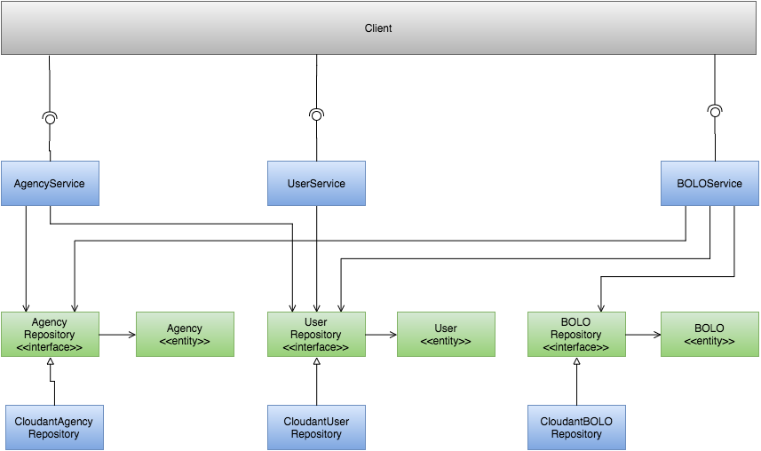
Minimal Class Diagram
Notes:
This is diagram shows the interactions between core objects, green are domain objects while blue are application layer objects.

Slide 5
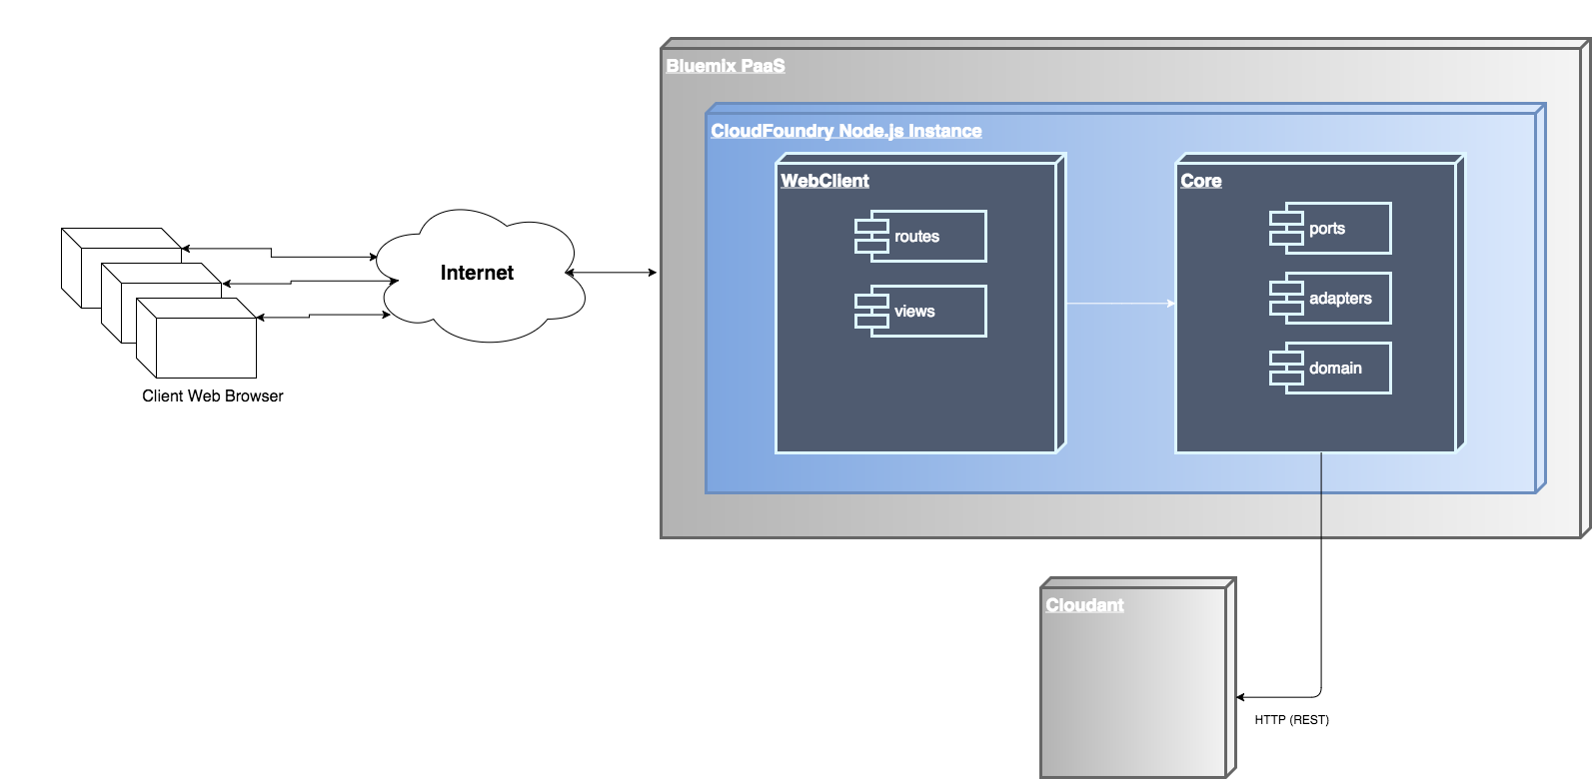
System Design: Deployment

Slide 6
Requirements: User Stories
[US 578] Officer Creates a BOLO
[US 596] Officer Updates a BOLO
[US 592] User Management (Epic)
[US 581] Choose Agency Alerts

Slide 7
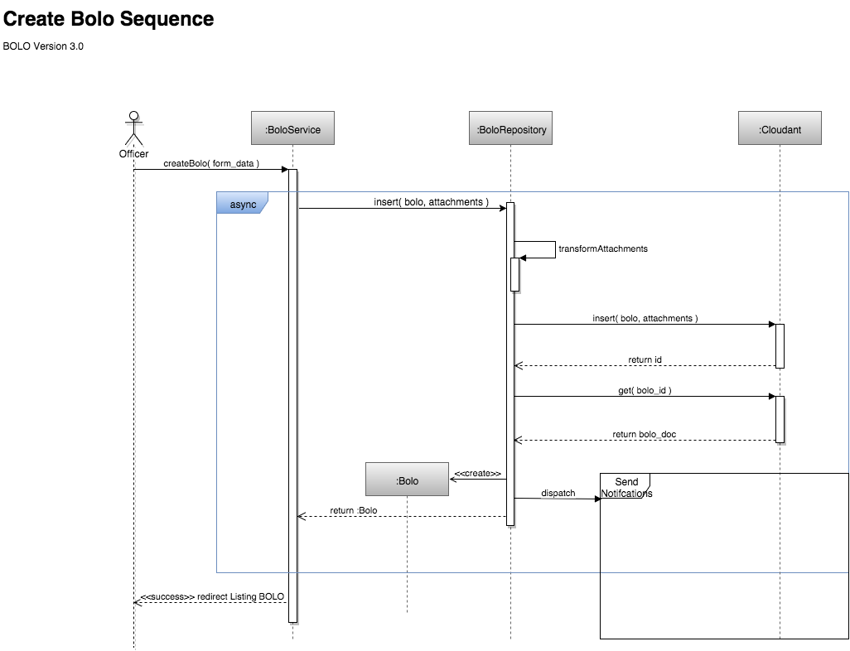

Slide 8
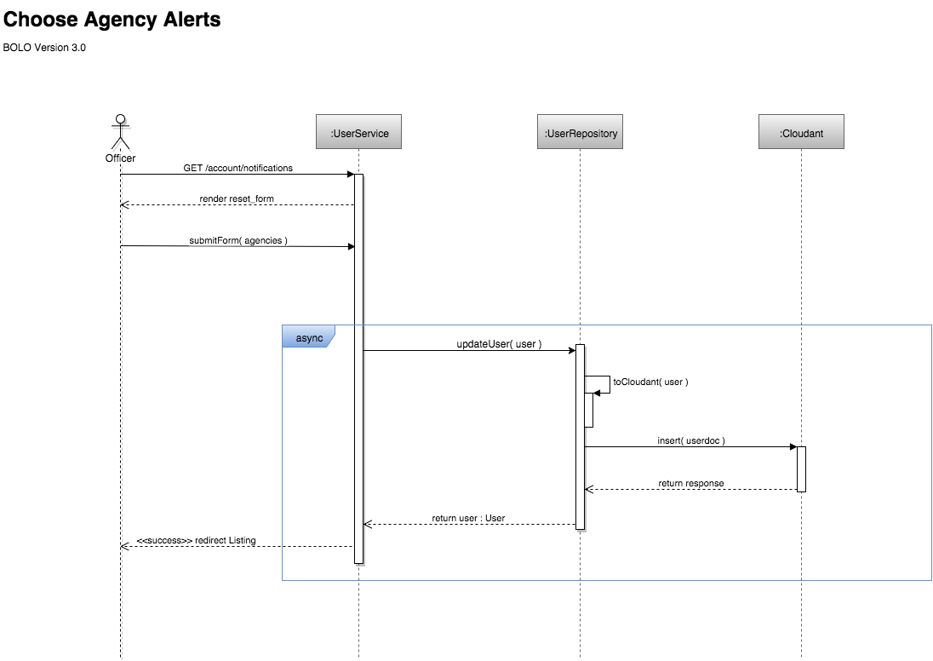

Slide 9
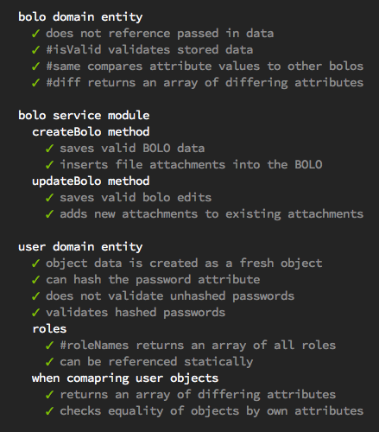
Test Suites and Test Cases
Test-First Development Workflow Used
All code written is unit tested
Mocha Javascript Test Runner with Chai assertion library
Acceptance Testing using Selenium IDE recording and verify* methods.

Slide 10
Summary
End-to-end development of account/user management features
Client-side, server-side, external service configuration
Originally using built-in WordPress account management
End-to-end development of BOLO creation and editing
BOLO attachments stored in the Cloudant
Wishlist Item: Store Full-res images in a CDN with optimized images in Cloudant
TDD Workflow

Slide 11
How to Contact
Email: delrosario.ryan@gmail.com
Twitter: @imrydr
LinkedIn: https://www.linkedin.com/in/ryan-del-rosario-b247659
Notes:
The best way to contact me is email, but feel free to try me on LinkedIn or Twitter

Slide 12
Questions

